Slide 1


Network and Spatial Analyses
12. February 2020
Lecture:
Course Introduction
Who, where, when, why?
Topics in Economic Geography I.
Uneven spatial distribution of economic activities
Agglomeration (economies) and clusters
Related variety
Seminar:
Introduction to R
Course Github page: https://github.com/bokae/anet_course

Slide 2






BALÁZS LENGYEL
(lengyel.balazs@krtk.mta.hu)
Head of ANET Lab
Institute of Economics
Lead Researcher
Corvinus University of Budapest
ESZTER BOKÁNYI
(bokanyi.eszter@krtk.mta.hu)
Junior Researcher
ANET Lab
ELTE
Department of Physics of Complex Systems
LÁSZLÓ CZALLER
(czaller.laszlo@krtk.mta.hu)
Junior Researcher
ANET Lab
ELTE
Department of Social and Economic Geography
SÁNDOR JUHÁSZ
(juhasz.sandor@krtk.mta.hu)
Junior Researcher
ANET Lab
ZOLTÁN ELEKES
(elekes.zoltan@krtk.mta.hu)
Junior Researcher
ANET Lab
Umeå University
Department of Geography
GERGŐ TÓTH
(toth.gergo@krtk.mta.hu)
Junior Researcher
ANET Lab
University College Dublin
Spatial Dynamics Lab

Slide 3
Assessment:
Participation in the lectures - 10%
All students must participate in the lectures. If you miss the upcoming class please write an email to toth.gergo@krtk.mta.hu. Missing more than 3 lectures results in a reduction from the participation grade.
Seminar activity - 20%
Students receive points based on their activity during the seminar. They should answer questions,formulate their own inquiries, and actively participate in the discussion.
Homework - 20%
During the semester, students have one homework exercise.
Semester project - 50%
For the project, students have to choose one topic related to the course and write a paper (minimum 1000 - maximum 4000 words) to demonstrate their understanding of the concepts and the data analysis methods acquired during the semester. The project paper must follow the attached guidelines! R script attached to the final paper is welcomed (not included in the word count)!
Deadline: During the exam-period, exact date TBA.

Slide 4
1) Course Introduction and Topics in Economic Geography I.
Seminar: Introduction to R
2) Topics in Economic Geography II.
Seminar: Econometrics reminder
3) Introduction to Networks I.
Seminar: Intro network exercise in R
4) Introduction to Networks II.
Seminar: Network measures and plots in R
5) No Class (11th of March)
6) Anatomy of Clusters
Seminar: EconGeo R package and Exponential Random Graph Models
7) Principle of Relatedness
Seminar: Netflix of regions
8) Spatial Equilibrium I.
Seminar: Project proposals (25th of March)
9) Spatial Equilibrium II.
Seminar: Introduction to GIS mapping
10) Zipf’s law and Urban scaling
Seminar: Scaling laws of politics and words
11) Easter (8-14. April)
12) Social and Communication Networks I.
Seminar: Communication networks on Twitter
13) Project presentations

Slide 5
Economic activities have an uneven spatial distribution.

Slide 6

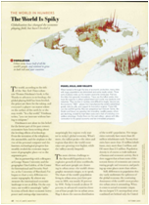
Flat world or spiky world
Flat world
Decreasing transportation cost of production factors, products, people and information.
Increasing global competition.
Deregulation and political-social integration.
Spiky world
International economic landscape with respect to economic output, growth and innovativity is not flat at all.
More and more people clustering in (global) cities.
Friedman (2005)
Florida (2005)

Slide 7
Global competition and the relevance of location
Global competition
Firms competing globally, developing strategies across borders.
Due to mobility, production factors are available for all.
Information, codified knowledge and technologies are diffused globally.
Relevance of location
Lasting differences between the economic performance of locations.
Leading globally competitive companies still have a home base where core competencies are concentrated.
Immaterial goods, skills and tacit knowledge are location-bound.
Sources of enduring competitive advantage are local (Porter 1998a).

Slide 8
Spatial division of labour
Division of labour
The separation of tasks within the production process and their allocation to different groups of workers.
Technical division of labour (Adam Smith and the pin factory).
Social division of labour.
Spatial division of labour
The concentration of particular sectors and/or production tasks in specific geographical areas (Massey 1984).
Contrast of branch plants and headquarters locations with respect to worker skills, innovation and entrepreneurship.
Inequalities and power relations.

Slide 9
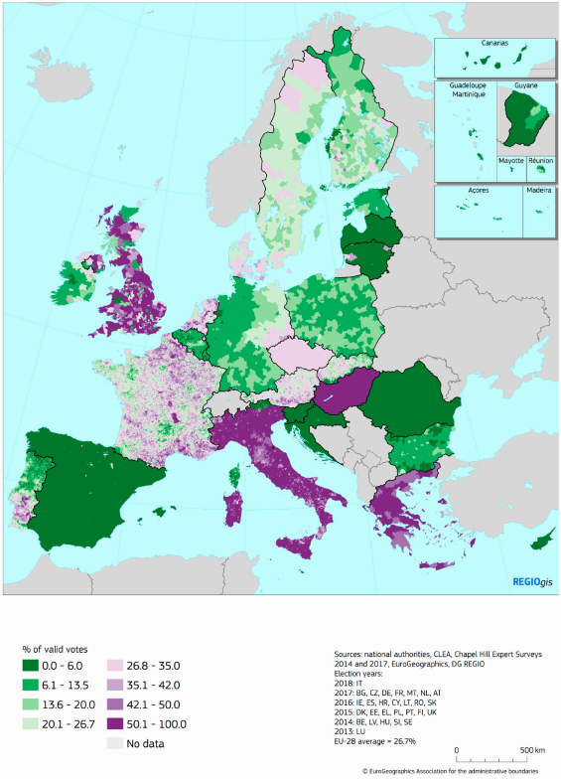
Revenge of the places that don’t matter
People in an increasing number of regions are experiencing their economic opportunities and welfare provision to be diminishing, which is directly linked to a growing political discontent (Rodríguez-Pose 2018).
Minimum share of the vote for parties somewhat opposed, opposed or strongly opposed to European integration, 2013–18. (Dijkstra et al. 2019, pp. 4.)

Slide 10
What is a location?
Regions
The division of space into subunits is not a priori given.
Besides the national level, supranational (global) and subnational (regional, local) levels structure economic activities.
Region types
Nodal region: consistent, has more-or-less definable boundaries, and is homogeneous with respect to the socio-economic phenomenon under investigation (e.g. labour market regions).
Planning region: statistical, planning and public governance (e.g. EU NUTS regions).

Slide 11
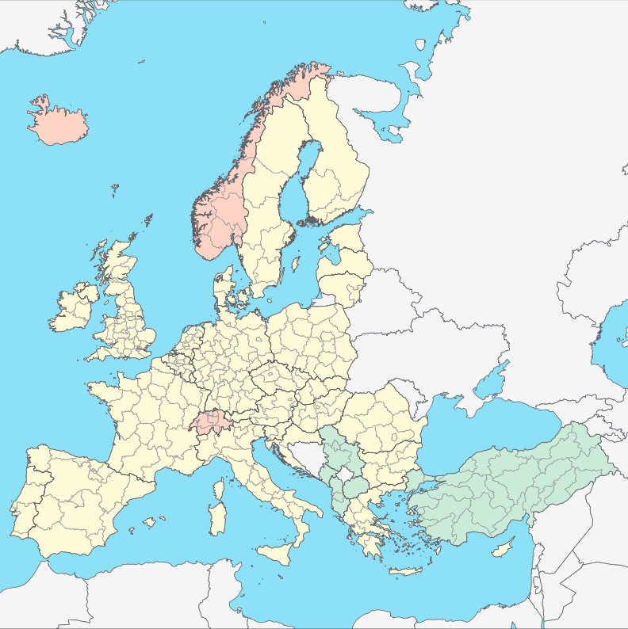
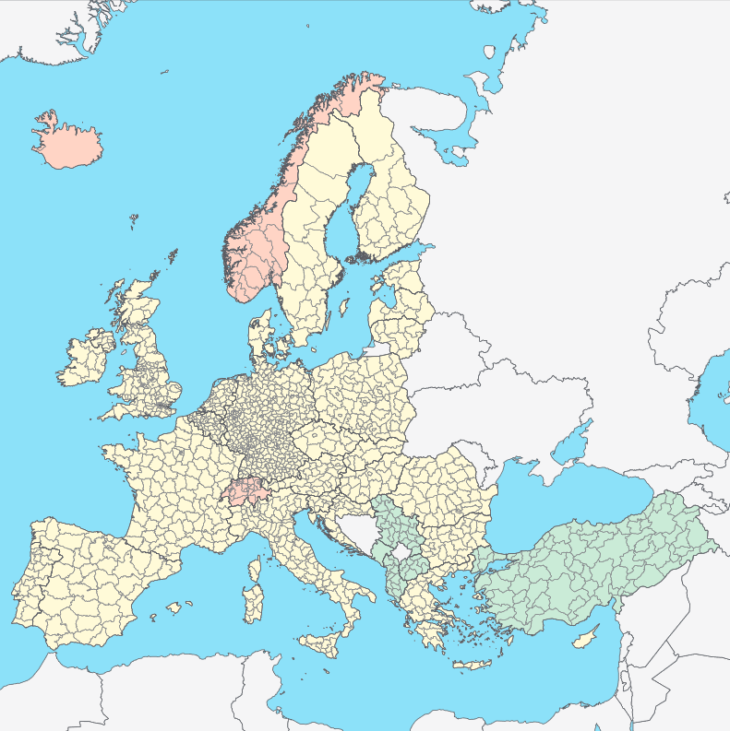
The NUTS system of the EU
NUTS 2 regions
NUTS 3 regions
https://www.ksh.hu/regionalatlas_eu_nuts

Slide 12
The spatial concentration of economic activities gives rise to externalities.

Slide 13
Perspectives on spatial concentration
New Economic Geography
Spatial concentration as a source of positive externalities.
Centrum-periphery model: the emergence of a C-P structure depends on transportation costs, returns to scale and the share of manufacturing activities (Krugman 1991, Fujita et al. 1999).
Business Studies
Spatial concentration as competitive advantage.
Clusters: to increase productivity, factor inputs must improve in efficiency, quality and ultimately specialization to particular cluster areas (Porter 1998b).

Slide 14
Agglomeration economies (externalities)
Agglomeration is the spatial concentration of economic activities.
Localisation economies (MAR): specialised local labour market, specialised local suppliers, local knowledge spillovers within industries.
Jacobs-externalities: advantages from the diversity of economic activities and knowledge spillovers between them.
Urbanisation economies: advantages of region size and size-efficient public services.
"After all, intellectual breakthroughs must cross hallways and streets more easily than oceans and continents." (Glaeser et al. 1992, pp. 1127.).

Slide 15



Micro-Foundations of Urban Agglomeration Economies (Duranton-Puga 2004)
Sharing
Matching
Learning

Slide 16
Industrial districts
Marshallian district
An industrial district is a sizeable and spatially delimited area of trade-oriented economic activity with a distinctive economic specialisation (Markusen 1996).
Marshallian New Industrial District and Third Italy.
Other variants
Hub-and-spoke district: few major companies and suppliers.
Satellite industrial platform: branch plants of absent multinational corporations.
State-centered district: major government tenant anchors the local economy.

Slide 17
Clusters
Clusters
A cluster is a critical mass of companies in a particular location (Porter 1998b).
A cluster allows each member to benefit as if it had greater scale or as if it had joined with others without sacrificing its flexibility.
Competitive advantage
Factor conditions.
Demand conditions.
Firm strategy, structure and rivalry.
Related and supporting industries.

Slide 18





Specialisation and diversity
Specialisation
Knowledge spillovers within industries.
Incremental, process innovation.
Diversity
Knowledge spillovers between industries.
Radical, product innovation.

Slide 19
Related activities tend to co-agglomerate in space.

Slide 20
Love Nothing is in the air
“When an industry has thus chosen a locality for itself, it is likely to stay there long [...]. The mysteries of the trade become no mysteries; but are as it were in the air, and children learn many of them unconsciously” (Alfred Marshall 1890, pp. 198.).
Being there is not enough when it comes to innovative activities of co-located firms in cities or clusters (Fitjar - Rodríguez-Pose 2017).
Knowledge does not behave as a public good at the micro-level.

Slide 21
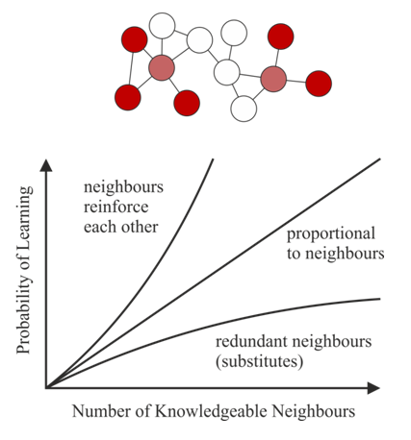
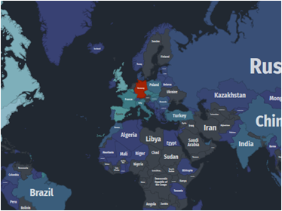
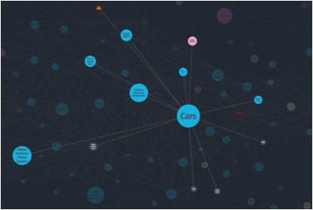
Collective learning
But who are these neighbours?
Nearby locations.
Related activities.
Hidalgo (2018)
https://atlas.media.mit.edu/

Slide 22
Proximity
Proximity (Boschma 2005)
Geographical proximity.
Institutional proximity.
Social proximity.
Organisational proximity.
Cognitive proximity.
Not too much, not too little
Optimal proximity to be conducive of learning and innovation.
Proximity-paradox (Broekel - Boschma 2012): proximity is a key driver for agents to connect and exchange knowledge, but too much proximity harms innovative performance.

Slide 23
Co-agglomeration, related activities and related variety
Co-agglomeration of industries
Manufacturing industries tend to co-agglomerate when there is a high degree of sharing of goods, labour and ideas (Ellison et al. 2010).
Related variety (Frenken et al. 2007)
Knowledge spillovers between industries may be realised when there is not much, nor not too little cognitive proximity.
Decomposition of overall industrial variety to related and unrelated components.
Jacobs-externalities arise when there is related variety among local economic activities.
Related activities in clusters
Related and supporting industries as sources of competitive advantage.

Slide 24
Literature
Boschma, R. (2005): Proximity and Innovation: A Critical Assessment. Regional Studies, 39, 1, 61-74.
Broekel, T. - Boschma, R. (2012): Knowledge networks in the Dutch aviation industry: the proximity paradox. Journal of Economic Geography, 12, 409-433.
Dijkstra, L. - Poelman, H. - Rodríguez-Pose, A. (2019): The geography of EU discontent. Regional Studies, DOI: https://doi.org/10.1080/00343404.2019.1654603
Duranton, G. – Puga, D. (2004): Micro-foundations of urban agglomeration economies. In Henderson, J. V. - Thisse, J-F. (eds.): Handbook of Regional and Urban Economics. Elsevier, Amsterdam, 2063–2117.
Ellison, G. - Glaeser, E. L. - Kerr, W. R. (2010): What Causes Industry Agglomeration? Evidence from Coagglomeration Patterns. American Economic Review, 100, 3, 1195-1213.
Fitjar, R. D. - Rodríguez-Pose, R. (2017): Nothing is in the Air. Growth and Change, 48, 1, 22-39.
Florida, R. (2005): The World is Spiky. The Atlantic Monthly, October.
Frenken, K. - Van Oort, F. - Verburg, T. (2007): Related Variety, Unrelated Variety and Regional Economic Growth. Regional Studies, 41, 5, 685-697.
Friedman, T. L. (2005): The World Is Flat: A Brief History of the Twenty-first Century. Farrar, Straus and Giroux.
Fujita, M. - Krugman, P. - Venables, A. J. (1999): The Spatial Economy. Cities, Regions, and International Trade. MIT Press.
Glaeser, E. L. - Kallal, H. D. - Scheinkman, J. A. - Shleifer, A. (1992): Growth in Cities. Journal of Political Economy, 100, 6, 1126-1152.
Hidalgo, C. (2018): Principles of Collective Learning. Keynote at the Innovation, Economic Complexity, and Economic Geography Workshop, MIT Media Lab, Boston.
Krugman, Paul (1991): Increasing Returns and Economic Geography. Journal of Political Economy, 99, 483-99.
Markusen, A. (1996): Sticky Places in Slippery Space: A Typology of Industrial Districts. Economic Geography, 72, 3, pp. 293-313.
Marshall, A. (1890): Principles of Economics. Macmillan, London and New York.
Massey, D. (1984): Spatial Divisions of Labour: Social Structures and the Geography of Production. Routledge, New York.
Porter, M. (1998a): Clusters and the New Economics of Competition. Harvard Business Review, Nov-Dec, 77-90.
Porter, M. (1998b): The Adam Smith Adress. Location, Clusters and the "New" Microeconomics of Competition. Business Economics, 1, 7-14.
Rodríguez-Pose, A. (2018): The revenge of the places that don’t matter (and what to do about it). Cambridge Journal of Regions, Economy and Society, 11, 189-209.

